Slide 1

Data Science Project Architecture
Putting everything together: math, code, data, scientific approach
Yordan Darakchiev
Technical Trainer
iordan93@gmail.com

Slide 2
sli.do #Data-Science

Slide 3
Table of Contents
High-quality code and software engineering best practices
Code conventions
Data science project structure
Improving code
Debugging, unit tests, performance tests
Reproducible research
Tools, methods, ideas

Slide 4
High-Quality Code
Best practices, guides, patterns

Slide 5
Code Conventions
Scientists usually don't care too much about code
Leads to several things
Scientists' code is sometimes hard to understand and maintain
Developers can have a hard time debugging, and / or communicating ideas
Why not take the best of both worlds?
Python guidelines ("The Zen of Python")
Google Python Style Guide
It’s good to have code conventions
Many people can write code as one
{Team / company > language > personal} conventions
import this

Slide 6
General Ideas
"It's not going to production anyway"
Often, this is your production code
"Why did I write this?"
Leave comments, and make your code self-documenting
Unit tests can also serve as documentation
Other assets (e.g. pdf documents, issues, project requirements, etc.) can also help on a higher level
Use descriptive names
Add meaningful context
Avoid misleading names, comments, etc.
Refactor the code when needed
Technical debt
Separate the code into smaller, single-purpose chunks

Slide 7
Naming Stuff
lower_with_under – variables, functions, files, folders
UPPER_WITH_UNDER – global constants
PascalCase – class names, folders
camelCase – only to conform to existing conventions
Notes
_leading_underscore – marks a private variable
Not truly private, only a signal to developers not to mess with it
__double_leading_underscore – “mangles” variable names
__double_underscores__ – special variables or methods
__name__, __doc__, __init__, __str__, __repr__, __len__, etc.
arr = np.array([1, 2, 3])
arr.__str__() # '[1 2 3]'
arr.__repr__() # 'array([1, 2, 3])'
arr.__len__() # 3

Slide 8
Readability
Use imports for modules and packages
Avoid global variables
Pollute the global scope
Can create subtle dependencies in the code
Try using function parameters (and / or classes)
List comprehensions, lambdas, conditional expressions
Okay for simple, one-line cases
Lexical scoping (closures) – use very carefully
print([x + 3 for x in range(3)])
sum_two_nums = lambda x, y: x + y
print("even" if a % 2 == 0 else "odd")
def summator(a): # Usage: summator(4)(5)
def inner_summator(b):
return a + b return inner_summator

Slide 9
Readability (2)
Whitespace
DO NOT mix tabs and spaces!
Prefer spaces (text editors replace 1 tab with 4 spaces by default)
This can create a lot of pain and sinister bugs
1-2 blank lines between variables, functions and methods
Use typography rules (e.g. 1 space after comma)
Comments
Avoid inline comments
Docstrings – a way of documenting the code, unique to Python
More info here
TODO comments: temporary code, short-term solution, or good enough but not perfect
x = x + 1 # Increment x by 1

Slide 10
Object-Oriented Programming
Python has OOP
For most of our purposes, it's not necessary
We have used a lot of objects but we didn't really need to create classes
We generally prefer a combination of procedural and functional style
If you're comfortable, feel free to use classes
All principles from other OOP languages apply
Once again, the goal is to create readable code, which is easier to maintain

Slide 11
Project Structure
How not to get lost

Slide 12
Notebook Structure
Similar to scientific papers
Imports – usually the first cell contains all imports
Title, author(s)
Abstract – not mandatory, but really good to have
Data manipulation process
Divided into sections and subsections
Most commonly: getting data, transformations, visualization, modelling, etc.
Conclusion(s)
Tips
Make sections self-contained, reduce dependencies
Create functions when possible
To avoid creating too many global variables

Slide 13
File Structure
Usually, projects have one notebook
You may include many notebooks if you wish
You can also import code from notebooks
Very long code can be separated in .py files
Not greatly recommended, but sometimes helps
E.g. if the file contains a lot of utility functions
Using: simply import the files
Using the file names
You can also create folders and import them
These are called "modules"
We usually put all code in a separate folder, e.g. libs or utilities
Data, images and other assets should also be in their own folders

Slide 14
Improving Code
How not to get your peers angry

Slide 15
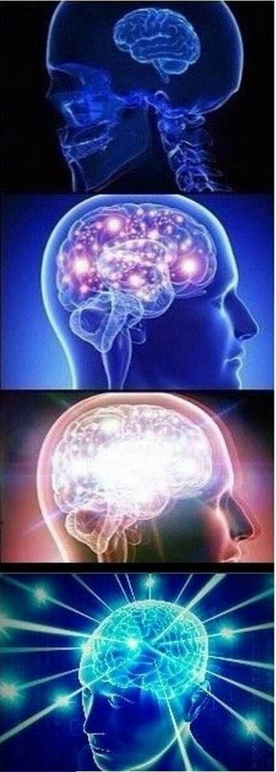
Debugging
Hardest way: don't debug at all
Easier: use print() statements at important places
Best: use a debugger to trace the code execution
Every IDE (such as Visual Studio, VSCode, PyCharm, etc.) has one
Most important concepts
Breakpoints
Step into, step over, step out
These usually have keyboard shortcuts assigned
Variable inspection
Interactive window; terminal
Call stack

Slide 16
Unit Testing
Debugging and testing are very scientific processes
Intuitive for most people with math / science background
Can show bugs in the code
Cannot show the code is bug-free!
"Absence of evidence is not evidence of absence"
Unit tests: pieces of code that test other pieces of code
Unit test layout: AAA (Arrange, Act, Assert)
def sum_numbers(a, b):
return a + b def test_sum_with_zeros():
a = 0
b = 0 result = sum_numbers(a, b) assert result == 0 test_sum_with_zeros()

Slide 17
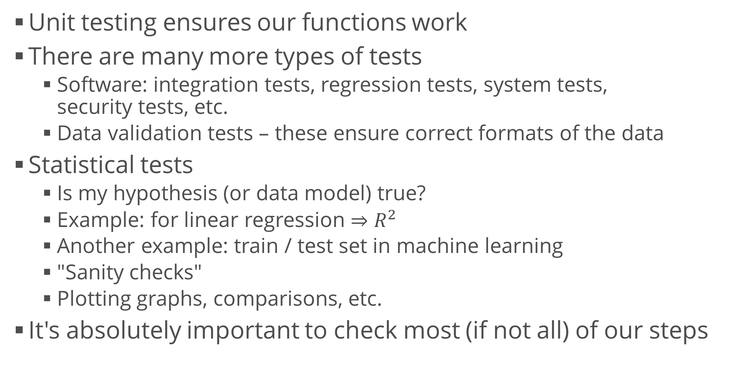
Other Types of Tests
Unit testing ensures our functions work
There are many more types of tests
Software: integration tests, regression tests, system tests, security tests, etc.
Data validation tests – these ensure correct formats of the data
Statistical tests
Is my hypothesis (or data model) true?
Example: for linear regression $⇒$ $R^{2}$
Another example: train / test set in machine learning
"Sanity checks"
Plotting graphs, comparisons, etc.
It's absolutely important to check most (if not all) of our steps

Slide 18
Performance Tests
Test how fast a code executes
Better: test the code complexity with different arguments
Possibly, plot the results
We can use the time library
Important: be careful how you check the time
Average execution over multiple trials to reduce random errors
Do not include initializations and "external" code
Code that you’re not interested in optimizing
Do not optimize prematurely!
start = time.time()
for i in range(1000):
sum(numbers)
stop = time.time()
print(stop - start)

Slide 19
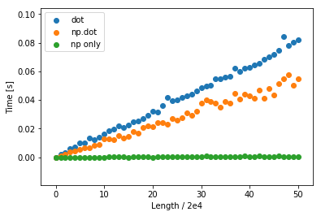
numpy Performance
numpy is really fast on arrays and matrices
It works in C "behind the scenes"
Takes advantage of all elements being of the same type
Vectorization – transforming the code so that it uses vectors and matrices
If possible, use numpy only
Avoid conversion to and from lists or other structures – this is slow
times = []
for test in range(51):
a = np.random.uniform(1, 10000, size = test * 20000).tolist()
b = np.random.uniform(1, 10000, size = test * 20000).tolist()
start = time.time()
a.dot(b) # Also: np.dot() on numpy arrays
stop = time.time()
times.append((stop - start))
plt.scatter(range(len(times)), times)

Slide 20
numpy Performance (2)
Example: grayscale image from RGB
1140 x 550px
The second block is easier to write, more intuitive, and 100x faster (0,05s vs 0,5s on my machine)
Correctness test
img = imread("...")
img_as_list = img.tolist()
start = time.time()
gs_img = []
for row in range(len(img_as_list)):
gs_img.append([])
for col in range(len(img_as_list[row])):
gs_img[row].append(0)
for row in range(len(img_as_list)):
for col in range(len(img_as_list[row])):
curr_sum = round(sum(img_as_list[row][col]) / 3)
gs_img[row][col] = curr_sum
stop = time.time()
print(stop - start)
(gs_img == np_img).all()
start = time.time()
np_img = img.mean(axis = 2).round().astype(np.uint8)
stop = time.time()
print(stop - start)

Slide 21
Reproducible Research
How to do stuff properly

Slide 22
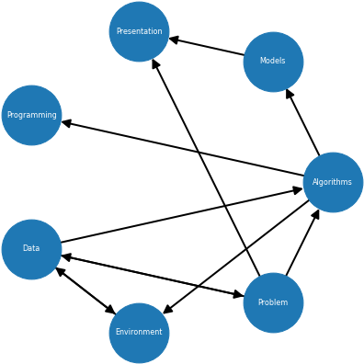
Data Science Process
As we know, the data science lifecycle is complex
For example, see this image
Also, there are a lot of topics
Components and dependencies
Problem (task)
Data (experiments, dataset; different forms)
Algorithms (e.g. linear regression, Bayesian model)
Models (testing, selecting, fine-tuning; normalizing data, etc.)
Programming (APIs, functions, testing)
Environment (packages, such as numpy; or tools, such as Excel)
Presentation (tables, KPIs, visualizations, software)

Slide 23
Reproducible Research
The whole process is complex, so we need a way to verify our work (and possibly other people's work)
Particularly important when a study affects decisions
Sometimes impossible: time, opportunity, money, etc.
Why is it so important?
It's the only thing we can guarantee about our study
Easiest way: supply all your data, and your notebooks
The notebooks contain all information about your research
Requirements: analytical (not raw) data; code; documentation of the code and processes
Markdown and LaTeX help us write more explicit documentation (in text and math format)

Slide 24
Reproducible Research (2)
Dos
Good science (interesting, relevant problem; communication)
Automation of tasks (as many as possible)
Version control usage
Even if you’re working alone, this helps you in the case something goes terribly wrong
Environment management (e.g. conda packages)
Sometimes: random seed, mock objects and other pseudorandom variables
Don'ts
Manually edited data
If we get a new version, we have to edit the data again
Omitted (deleted) steps of the process
If a step you perform is not in your notebook, it can’t be replicated easily

Slide 25
Comparing to Previous Work
Both yours (if you have some) and others'
In the beginning: to see what others have done
In the end: to compare your findings to others'
This can be a software product, or a paper, or something else
Example: see papers at arXiv
Good examples of a scientific article layout
Example 2: Kaggle notebooks (kernels)
Don't forget to cite everyone that you've borrowed ideas, code, research methods, or information from
Reason 1: If they are proven wrong, your research may be wrong too
Reason 2: You're not plagiarizing them

Slide 26
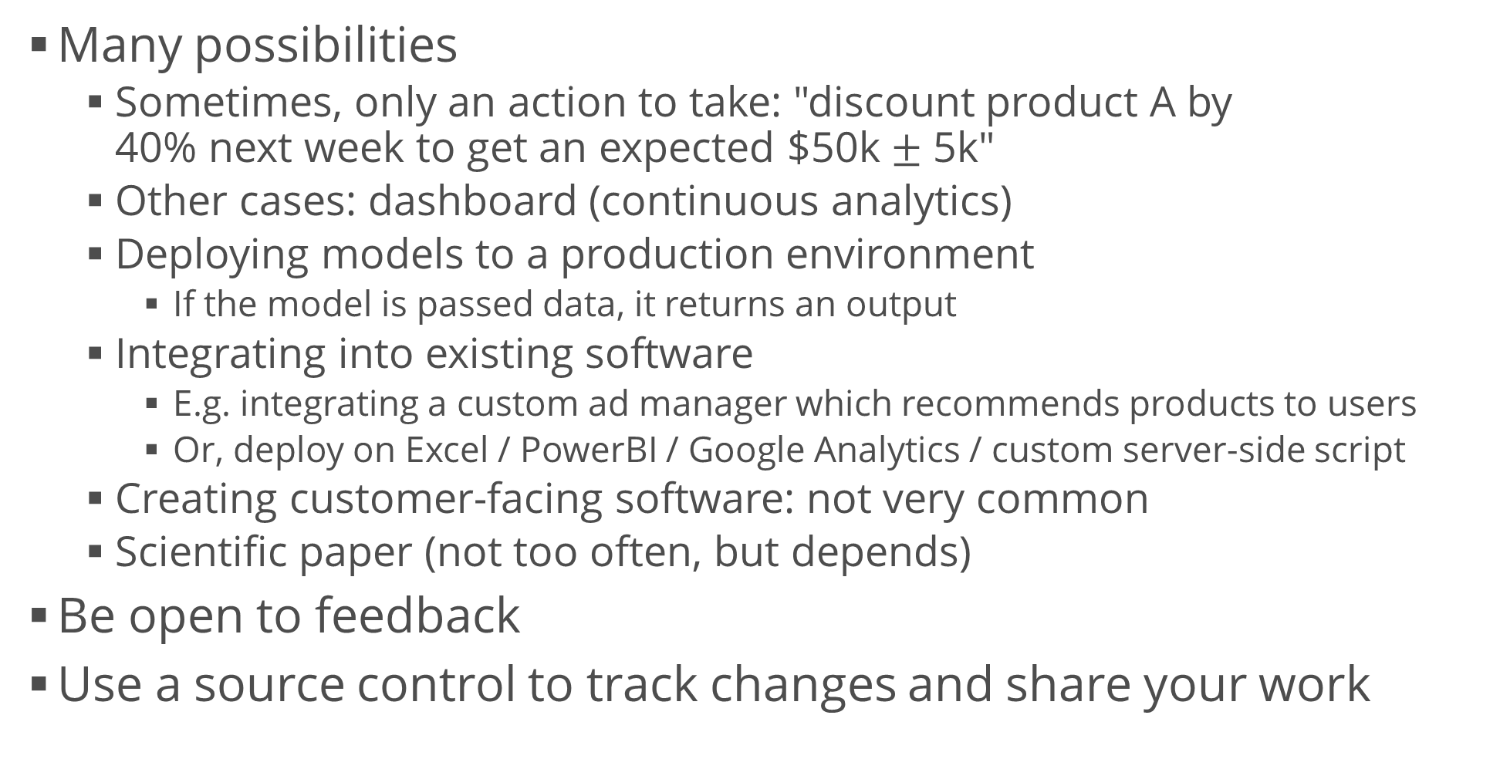
Communicating Results
Many possibilities
Sometimes, only an action to take: "discount product A by 40% next week to get an expected $50k $±$ 5k"
Other cases: dashboard (continuous analytics)
Deploying models to a production environment
If the model is passed data, it returns an output
Integrating into existing software
E.g. integrating a custom ad manager which recommends products to users
Or, deploy on Excel / PowerBI / Google Analytics / custom server-side script
Creating customer-facing software: not very common
Scientific paper (not too often, but depends)
Be open to feedback
Use a source control to track changes and share your work

Slide 27
Evidence-Based Analysis
Once again, the entire process is very long
At each step, we're making a lot of choices
Sometimes without even realizing it
E.g., default parameters in algorithms, default settings, assumptions about the data
Main idea
Don't take these decisions randomly (or unknowingly)
Base them on previous research
This reduces the "degrees of freedom"
Therefore, accounts for better reproducibility
Also, guarantees that the used methods are widely accepted

Slide 28
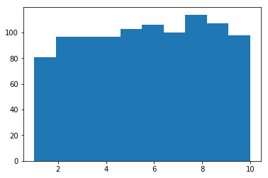
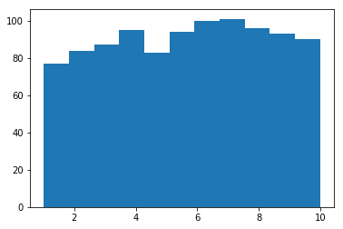
Evidence-Based Analysis (2)
Example
Default choice: 10 bins vs. Freedman – Diaconis bin size rule
np.random.seed(120)
x = np.random.uniform(
1, 10, size = 1000)
hist, bins = np.histogram(x, bins = "fd")
width = (bins[1] - bins[0])
center = (bins[:-1] + bins[1:]) / 2
plt.bar(center, hist, align = "center", width = width)
plt.hist(x)

Slide 29
Last Note: Cognitive Biases
No matter how good we are, we're all susceptible to biases in our reasoning
These can be used for good or bad
List of biases
Some popular ones: anchoring, choice support and "ostrich effect", confirmation bias, survivorship bias
We, as researchers, should try to overcome as many of these as possible
This will also help find flaws in other people's methods
How to Spot a Fake News Story
Three Ways to Spot Logical Fallacies
StatsDoneWrong website

Slide 30
Summary
High-quality code and software engineering best practices
Code conventions
Data science project structure
Improving code
Debugging, unit tests, performance tests
Reproducible research
Tools, methods, ideas

